Slide 1
UI Basics 3
Guangjian Zhou

Slide 2
Why were client-side frameworks like Angular introduced?
It was designed by Google to enable developers to create dynamic and interesting web applications. Using this framework, developers can build front-end-based apps without using any other plugins or frameworks. Freelancer.com, Netflix, GoodFilms and many other sites have been built using Angular.

Slide 3
How does an Angular application work?
Angular follows component based architecture, in component-based architecture, a large application is broken (decoupled) into functional and logical components. These components are reusable hence can be used in any other part of the application. These components are independent hence can be tested independently, this architecture makes Angular code highly testable.

Slide 4
What are some of the advantages of Angular over other frameworks?
1. Functionality out of the box
2. TypeScript
3. Consistency
4. Productivity
5. Maintainability
6. Modular development structure
7. Angular Material

Slide 5
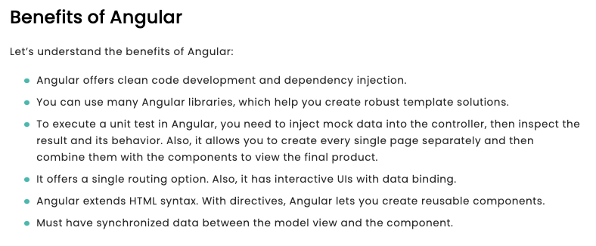
What are the advantages of Angular over React?
MVC Model
Dependency Injection
Out-of-the-box Full Stack Framework
Two-way Data Binding
Amazing App Structure

Slide 6
List out differences between AngularJS and Angular?
One vital distinction between Angular vs AngularJS is AngularJS is JavaScript-based while Angular is TypeScript based.
Angular has standard Directives while AngularJS has a pack of them.
AngularJS has a model-view-controller (MVC) that acts as the central component as it manages data, logic, and rules, and expresses how the applications behave. AngularJS has a model-view-controller (MVC) that acts as the central component as it manages data, logic, and rules, and expresses how the applications behave.
AngularJS does not provide mobile support while Angular supports mobile.
AngularJS uses a two-way data binding feature ultimately reducing the development time and efforts. Angular on the other hand upgraded to a better structure of the same two-way data binding, which provides improved performance and speed for the production application.
By default AngularJS applications used either AngularJS locally by importing the minified source code inside a project or through a CDN. On the other hand, Angular uses the Command Line Interface (CLI) to reduce the time when creating and scaffolding applications.

Slide 7
How are Angular expressions different from JavaScript expressions?

Slide 8
What are Single Page Applications (SPA)?
An SPA (Single-page application) is a web app implementation that loads only a single web document, and then updates the body content of that single document via JavaScript APIs such as XMLHttpRequest and Fetch when different content is to be shown.
This therefore allows users to use websites without loading whole new pages from the server, which can result in performance gains and a more dynamic experience, with some tradeoff disadvantages such as SEO, more effort required to maintain state, implement navigation, and do meaningful performance monitoring.

Slide 9
What are templates in Angular?
A template is a form of HTML that tells Angular how to render the component. Views are typically organized hierarchically, allowing you to modify or show and hide entire UI sections or pages as a unit. The template immediately associated with a component defines that component's host view.

Slide 10
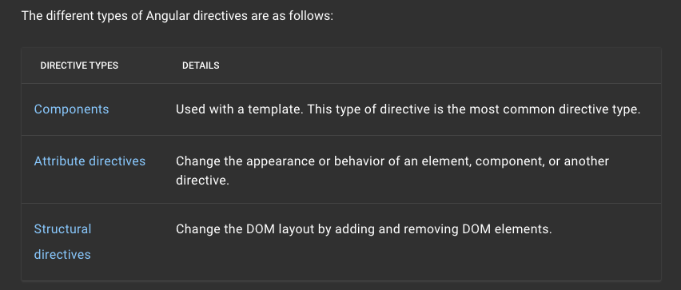
What are directives in Angular?
Directives are classes that add additional behavior to elements in your Angular applications. Use Angular's built-in directives to manage forms, lists, styles, and what users see.

Slide 11
Explain Components, Modules and Services in Angular
Modules, components and services are classes that use decorators. These decorators mark their type and provide metadata that tells Angular how to use them.
The metadata for a component class associates it with a template that defines a view. A template combines ordinary HTML with Angular directives and binding markup that allow Angular to modify the HTML before rendering it for display.
The metadata for a service class provides the information Angular needs to make it available to components through dependency injection (DI)

Slide 12
What is the scope?

Slide 13
What is data binding in Angular?
Data binding in AngularJS is the synchronization between the model and the view. When data in the model changes, the view reflects the change, and when data in the view changes, the model is updated as well.

Slide 14
What is two way data binding in Angular?
The two-way data binding in Angular is used to display information to the end user and allows the end user to make changes to the underlying data using the UI. This makes a two-way connection between the view (the template) and the component class. This is similar to the two-way binding in WPF.

Slide 15
What are Decorators and their types in Angular?
Decorators are functions that are invoked with a prefixed @ symbol, and are immediately followed by a class, method or property. They allow a service, directive or filter to be changed before being used. Basically, a decorator provides configuration metadata that determines how the component, class or a function should be processed, instantiated and used at runtime.
Class Decorators
Property Decorators
Method Decorator
Parameter Decorators
Custom Decorator

Slide 16
What are annotations in Angular ?
Annotation is a block of text that can be displayed over a node or connector. Annotation is used to textually represent an object with a string that can be edited at runtime. Multiple annotations can be added to a node/connector.

